Slide 1
2020
www.petrovax.ru

Slide 2
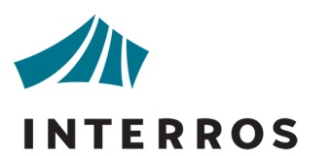
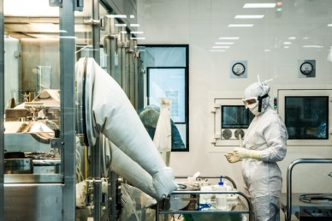
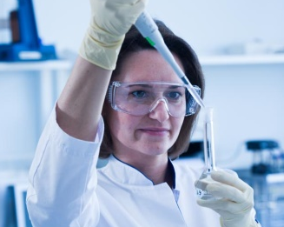

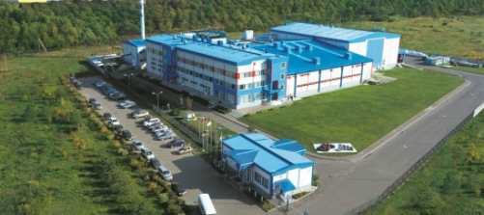

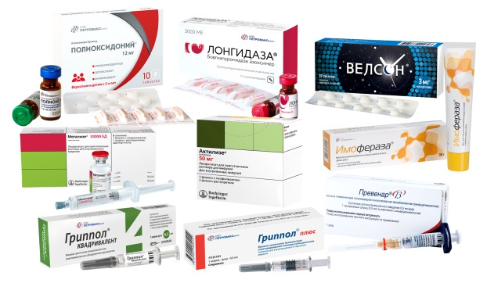

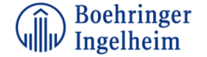
02
Petrovax
A Russian full-cycle biopharmaceutical company with
a 20-year record of success on the pharma market
An Interros Group company
R&D Center
> 20 worldwide patents
Pharmaceutical exports to the EAEU, EU, and Iran.
The company is among
the Top-5 immunobiological manufacturers in Russia
A partner
of leading global pharmaceutical companies
A full-cycle biopharmaceutical company
GMP and ISO-compliant manufacturing facilities
> 600 highly skilled employees
Portfolio of original and generic pharmaceutical products

Slide 3
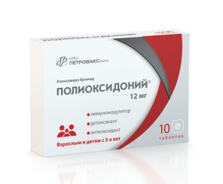
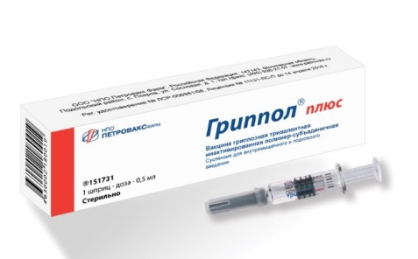
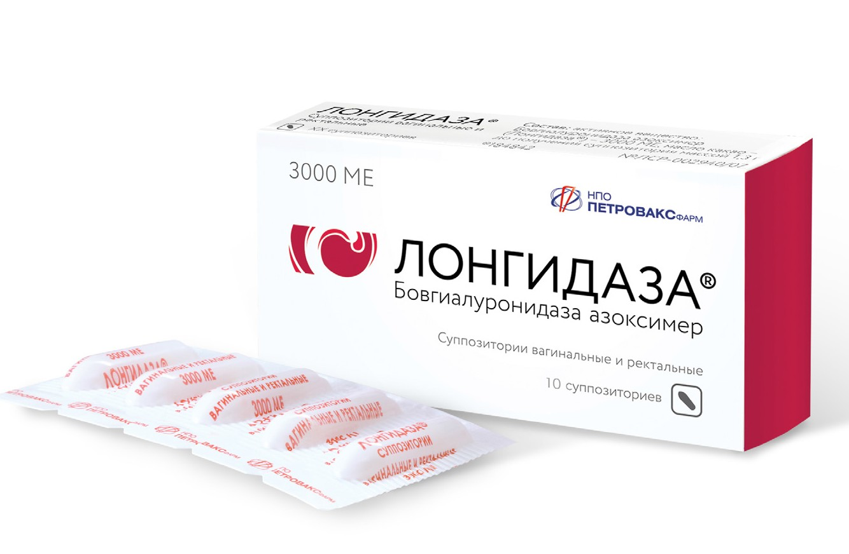
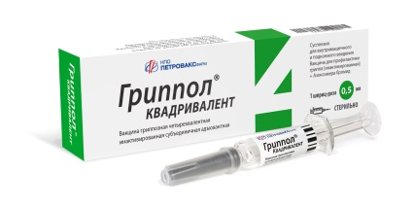
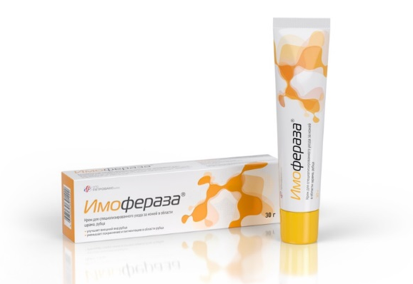
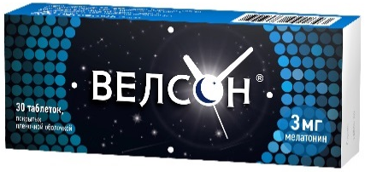
PRODUCT PORTFOLIO
Polyoxidonium®
03
(Azoximer bromide)
A original, multi-purpose pharmaceutical product with immunomodulating, detoxifying, and antioxidative properties.
The product is indicated for the treatment and prevention of respiratory infections as well as for the treatment efficacy improvement in gynecology and urology.
Velson®
Longidaze®
(melatonin)
A modern medication for sleep normalization and human biorhythms. Velson ® regulates the sleep-wake cycles, provides for quicker falling asleep, jet lag and weather changes adaption in meteopathic individuals. It is good for the emotional personality sphere (mood) and intellectual and mnestic functions of the brain (intelligence, memory).
(Bovhyarulonidase azoximer)
Grippol® plus
  An advanced combined-effect enzyme for the treatment of connective tissue hyperplasia conditions
(Influenza vaccine [inactivated] + Azoximer bromide)
  A Russian trivalent inactivated influenza vaccine, preservative-free, in pre-filled syringes
Grippol® Quadrivalent
Imoferaza®
(Influenza vaccine [inactivated] + Azoximer bromide)
  A specialized external scar revision cream for the care of scars and cicatrical tissue; it contains immobilized hyaluronidase, an unique enzyme.
  The first Russian quadrivalent inactivated subunit influenza vaccine to protect against 4 flu virus strains, i.e. 2 virus А strains (A/H1N1 + A/H3N2), and 2 lineages of influenza B virus(B/Yamagata + B/Victoria). It is preservative-free, and supplied
  in pre-filled syringes.

Slide 4
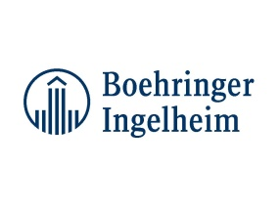
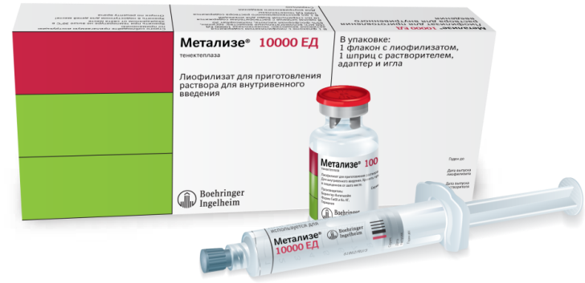
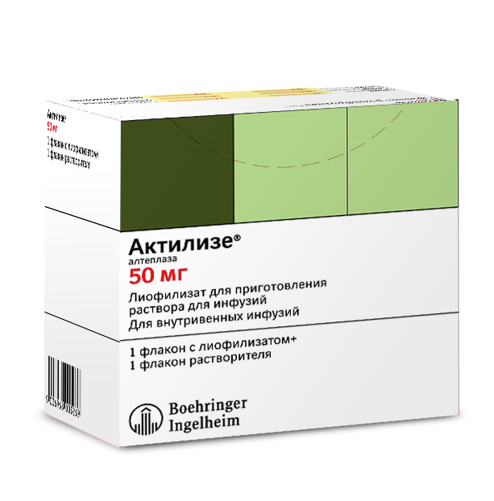
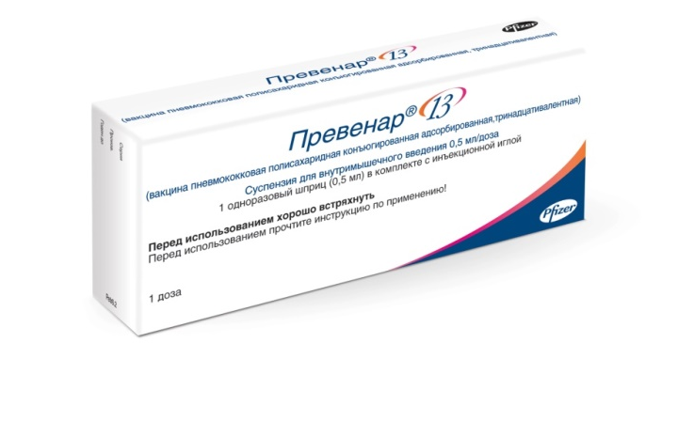

INTERNATIONAL PROJECTS
LOCALIZED PHARMACEUTICALS
A vaccine for prevention of pneumococcal infections caused by Streptococcus pneumoniae, serotypes 1, 3, 4, 5, 6A, 6B, 7F, 9V, 14, 18C, 19A, 19F, and 23F, such as sepsis, bacteremia, meningitis, pneumonia, and acute otitis media.
Indicated for subjects aged 2+ months without further age restrictions.
The finished dosage form is manufactured as a full-cycle process by Petrovax in cooperation with Pfizer.
04
An innovative thrombolytic agent for the treatment of myocardial infarction. The only recommended single-injection, bolus-dose (for 5-10 seconds) thrombolytic agent in the world to be used in the emergency care setting in patients with acute myocardial infarction to provide medical aid within the shortest time possible.
Currently, tenecteplase is one of the most thoroughly studied thrombolytics worldwide.
Manufacturer: Petrovax in cooperation with Boehringer Ingelheim.
Prevenar® 13
(13-valent polysaccharide adsorbed pneumococcalvaccine)
Actilyse®
(Alteplase)
Metalyse®
(Tenecteplase)
A biotechnology thrombolytic agent to treat both myocardial infarction and ischemic stroke (which is major advantage and a unique evidence-based indication).
Alteplase is the only thrombolytic medication indicated in patients with ischemic stroke within 4.5 hours following the onset of the symptoms.
Manufacturer: Petrovax in cooperation with Boehringer Ingelheim.

Slide 5
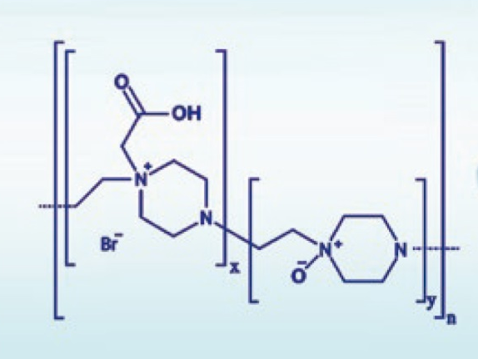



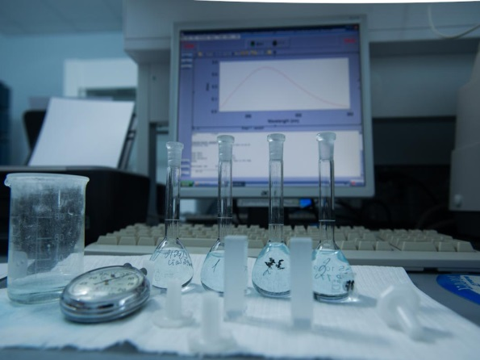
05
An advanced search for promising candidate molecules with further preclinical evaluation of safety and potency.
Mechanism-of-action studies in the disease pathogenesis setting for the products under development.
R&D
Petrovax’s development concept is based on branded products. The R&D and Implementation Department structure provides for the molecule inception and the product lifecycle support from the idea to practical implementation. Ad hoc research involves leading local and foreign industry-specific scientific institutions.
Preclinical safety and efficacy studies for medicinal products-to-be.
The development of quality control techniques and production process.
In-house vivarium
Petrovax has an in-house certified state-of-the-art vivarium with four types of laboratory animals used for clinical trials of own pharmaceutical products and providing CRO services. Specific temperature/humidity parameters and light conditions are maintained in the animals’ rooms to provide for keeping SPF mice and rats as well as common breeds of rabbits and Guinea pigs.
Preclinical data from in-house studies make the foundation for marketing authorization applications for the products developed by Petrovax. The company’s R&D units have been issued ISO:9001 quality certificates.
Planning and management of GCP-compliant authorization clinical trials. Implementation of innovative technologies; optimization
of state-of-the-art processes; production scale-up.

Slide 6
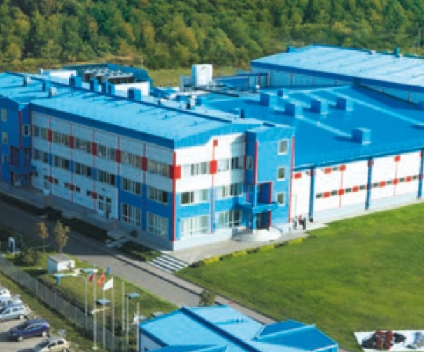


06
The company’s state-of-the-art pharmaceutical manufacturing and warehousing complex was put in operation in Moscow Region in 2008 and is among Russia’s most advanced high-tech biopharmaceutical facilities. Petrovax is the first Russian immunobiological manufacturer to be issued international GMP certificates by the state regulatory authorities of the EU (Slovakia) and Iran.
Production
The company manufactures active pharmaceutical ingredients (APIs) and liquid, semi-solid, and solid dosage forms in pre-filled syringes, ampoules, vials. Its production capacities provide for releasing over 160 million shots of immunobiologicals a year.
Petrovax is a full-cycle pharmaceutical company. Manufacturing facilities are fully compliant with the applicable Russian and international GMP standards and ISO 9001:2015 (cleanliness class zoning, raw and other material, personnel, intermediate and finished product flows).
1st production line: pre-filled syringe products
2nd production line: injectables in ampoules and vials
3rd production line: APIs, semi-solid,
and solid dosage forms

Slide 7
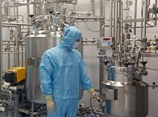
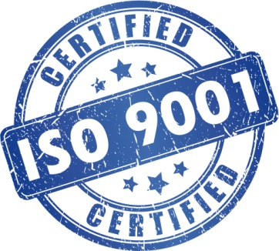
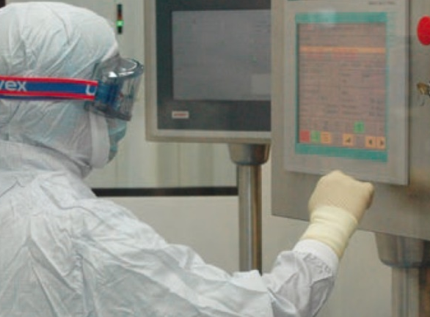
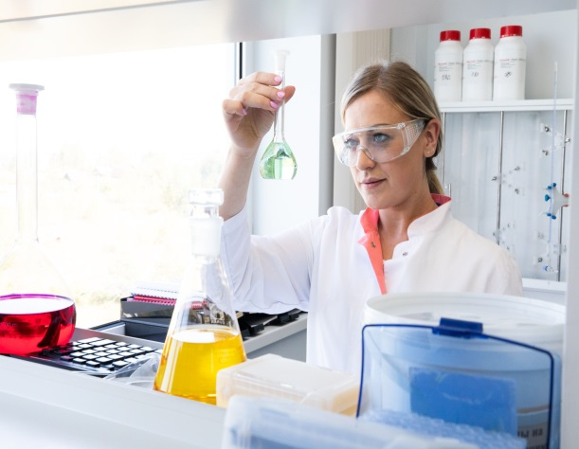
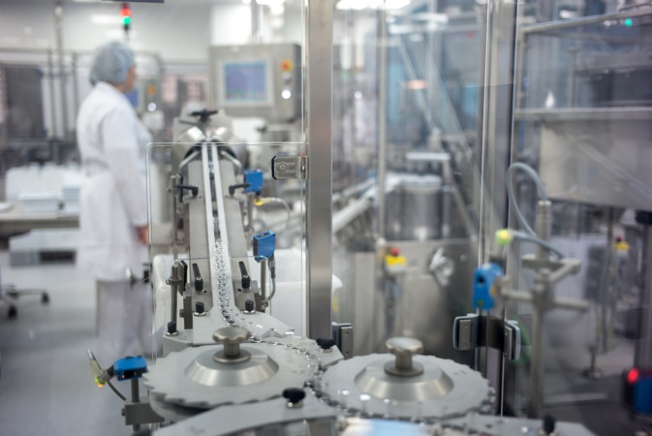
07
The QMS high-level performance is annually certified through a comprehensive audit by ISO certification authorities.
The document workflow system provides for keeping track of all actions by the employees engaged in product manufacturing and quality control, both
in real time and historically.
Quality
The company cooperates with approved raw and other material suppliers only.
The company has an automated training system in place: WebTutor, an education and professional development web portal, provides each employee with an individual QMS training and testing plan.
Petrovax has an effective quality management system (QMS) in place, with an ISO 9001:2015 certificate issued.
Importantly, QMS covers not only the production unit but also all other units, including the R&D unit and the company’s office.
A pharmacovigilance system is in place at the company that is run in compliance with the applicable international and Russian regulatory guidelines. To provide for product safety control, the company’s pharmacovigilance responsible persons continuously monitor the relevant product efficacy and adverse event data.

Slide 8
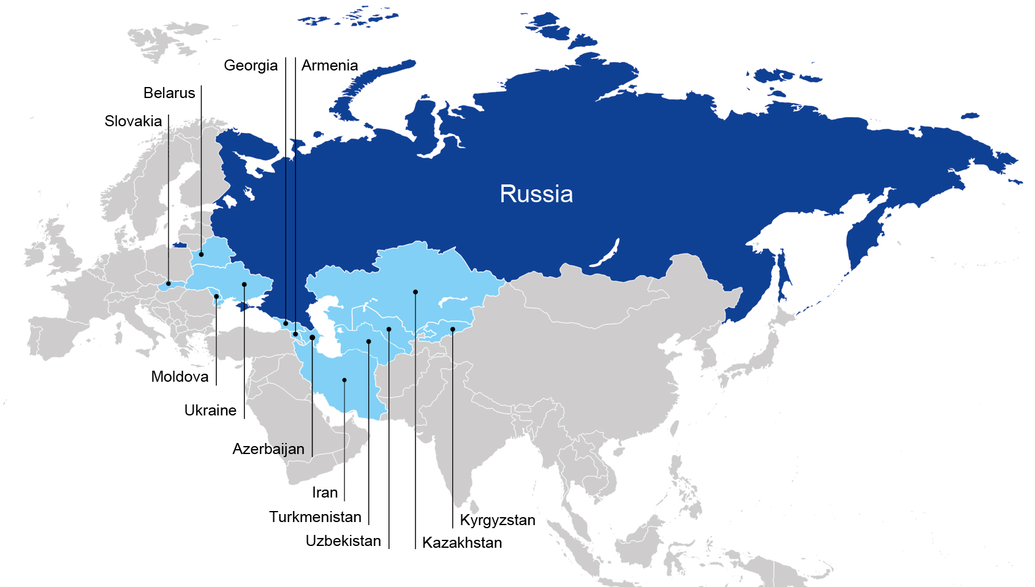


08
Geography
Petrovax’s strategic goals include the expansion of export potential and geographic footprint in respect of sales.
The company operates in all Russian regions and exports its pharmaceutical products to 12 countries.
Prospective export areas: the South-Eastern Europe, Egypt and other MENA countries.
>30
>10
Russia’s largest cities
Export countries
Belarus: in 2015, the first in the Russian history manufacturing localization project was implemented that involved the Russian branded Grippol® plus influenza vaccine to be produced in Belarus under the agreement with the Belorussian Ministry of Health and the Republican Unitary Enterprise ‘Belmedpreparaty’.
Iran: a strategic cooperation aimed to localize production of Grippol® plus influenza vaccine in Iran as well as transfer the relevant 4-valent polymer subunit influenza vaccine production technologies.

Slide 9

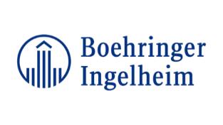
A biotechnological project unique to the Russian scientific and production areas
09
GMP-compliant facility construction.
Personnel training and implementation of GMP-compliant sterile vaccine manufacturing standards.
Production of the first Russian Grippol® plus mercury preservative-free vaccine in pre-filled syringes. Since 2009, the vaccine has been procured for the National Immunization Schedule.
More than 120 million people were immunized with Grippol® plus over the entire successful vaccination period, including under the Russian National Immunization Schedule as well as in the EAEU and Iran .
International Projects
Localization of immunobiological products in Russia with a transfer of innovative full-cycle production technologies
Localization of Prevenar® 13, a 13-valent conjugate pneumococcal vaccine, in Russia including a full-cycle production, control and quality assurance technology in compliance with the applicable international GMP standards.
Since 2014, the pneumococcal vaccine has been supplied under
the Russian National Immunization Schedule. In 6 years,
22 million vaccine shots were supplied .
Production potential for foreign markets.
Petrovax collaborates with leading Russian and international research institutes and pharmaceutical companies to develop new products and transfer full-cycle pharmaceutical manufacturing technologies.
Localization of full-cycle production of cardiac pharmaceuticals
Petrovax is the second site in the world manufacturing Boehringer Ingelheim’s innovative thrombolytic agents.
The production capacities provide for fully meeting the relevant patient demand in Russia.
2017: first commercial batches produced.
2019: a full-cycle manufacturing process was implemented.

Slide 10
NPO Petrovax Pharma LLC
12 Presnenskaya embankment, Federation Tower East, floor 38
Moscow 123112, Russia
Tel. : +7 (495) 730-75-45
E-mail: info@petrovax.ru
www.petrovax.ru

